Slide 1
Line Frequency Controlled Rectifiers
Controlled dc output voltage
varies from +ve maximum to –ve maximum.
Controllable devices like thyristors, IGBT BJT are used.
Commutation of the devices depends on the ac side line frequency.
Hence the name line frequency rectifiers.

Slide 2
Dc side current is always +ve
Dc side voltage is +ve or -ve.
+ve voltage and +ve current at dc side indicates rectification mode. Power flows from ac side to dc side.
operating points lie in the first quadrant of V_{d}-I_{d} plane.
V_{d} Average voltage at DC side
I_{d} Average current at DC side
-ve voltage and +ve current at dc side indicates inversion mode. Power flow is from dc side to ac side.
operating points lie in the fourth quadrant of V_{d}-I_{d} plane.

Slide 3
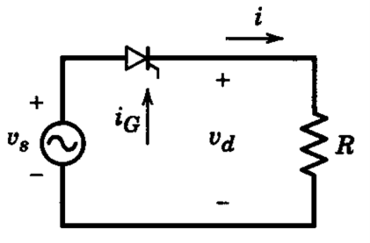
Single phase half wave controlledrectifier
T₁
R load
0 → α
T₁ is off.
i =0.
At ωt = α , T₁ is triggered on
α → π
T₁ is on.
v_{d} = v_{s} i =v_{d}/R = v_{s}/R =
i_{s} = i
At ωt = π, i = 0
π →2π
T₁ is off.
i = 0. v_{d} = 0. i_{s} = 0 v_{T1} = v_{s}
i_{s}

Slide 4
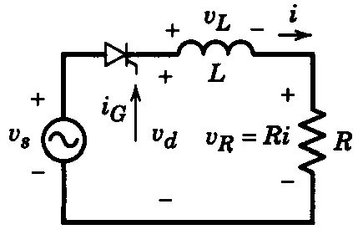
R-L load
0 → α
Switching device is off.
i = 0 V_{d} = 0
V_{L} = 0 , V_{R} = 0
V_{T} = v_{s}
α → θ₂
Thyristor is on.
V_{d} = = v_{s} =
i =
v_{R} (t) = Ri(t)
v_{L} (t)= v_{s}- v_{R} (t)
At ωt= θ₁
di/dt = 0, v_{L} = 0,
v_{R} = v_{s}
Area A1 = Area A2
Energy stored in the inductor during α to θ₁ is sent back to ac source during θ₁ to θ₂

Slide 5
R-L load with a freewheeling diode
↓
i_{d}

Slide 6
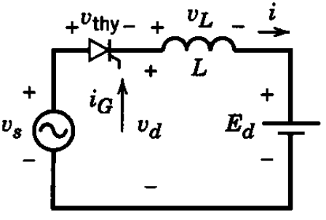
L-E load
θ → α
T is forward biased and off.
i = 0
V_{d} = E_{d}
V_{L} =0
V_{T} = v_{s} - E_{d}
At α Thyristor is forward biased and triggered.
α →β
Thyristor is conducting.
V_{d} = v_{s}
V_{L} =L di/dt = v_{s} - E_{d}
V_{T} = 0
0 → θ
T is reverse biased.
i = 0
V_{L} = 0
V_{d} = E_{d}
V_{T} = v_{s} - E_{d}

Slide 7
At β, i = 0, T becomes off.
β → 2π
Thyristor is off
i = 0
V_{L} = 0
V_{d} = E_{d}
V_{T} = v_{s} - E_{d}

Slide 8
θ → α
Thyristor is forward biased and in the off state.
i_{d} = 0
v_{d} = E_{d}
v_{R} =0
v_{T} = v_{s} - E_{d}
R-E load
0 → θ
Thyristor is reverse biased.
i_{d} = 0
v_{d} = E_{d}
v_{R} = 0
v_{T} = v_{s} - E_{d}
α →∏- θ
Thyristor is forward biased and in the on state.
V_{d} = v_{s}
v_{R} =Ri = v_{s} - E_{d}
i = (v_{s} - E_{d} )/R
V_{T} = 0

Slide 9
At ∏- θ,
i_{d} = 0
Thyristor becomes off
∏- θ → 2∏
v_{d} = E_{d}
v_{R} =0
v_{T} = v_{s} - E_{d}

Slide 10
Single phase Fully Controlled bridge rectifier
R Load

Slide 11
R – L Load
Discontinuous load current mode
α → θ₁
T₁ and T₂ conduct
v_{d} = v_{s}
i_{d} =
θ₁ → π+α
i_{s} = i_{d}
T₁ T₂ T₃ and T₄ remain in the off state
v_{T1} =0, v_{T2} =0
i_{s} = i_{d} = 0 , v_{d} = 0
v_{T3} =
At ωt=θ₁ , i_{d} =0
i_{T1} = i_{T2} =0
Both T₁ and T₂ go to the off state

Slide 12
π+α → π+θ₁
v_{d} = = -v_{s}
i_{d} =
i_{s} = - i_{d}
v_{T1} = v_{s}= v_{T2}
At ωt = π +θ₁ , i_{d} =0
i_{T3} = i_{T4} =0
Both T₃ and T₄ go to the off state
π+θ₁ → 2π+α
T₁ T₂ T₃ and T₄ remain in the off state
i_{s} = i_{d} = 0 , v_{d} = 0,
T₃ and T₄ conduct

Slide 13
R – L Load, Continuous Current Mode
For ωt < α, T₃ & T₄ were conducting
At ωt = α, i_{d} = I₁ (≠0)
T₁ and T₂ are turned on
T₃ and T₄ are line commutated
α →∏ + α
T₁ and T₂ conduct. T₃ and T₄ are in the off state
V_{d} = V_{s} =
i_{d} =
i_{s} = i_{d}
V_{T3} = - v_{s} = V_{T4}

Slide 14
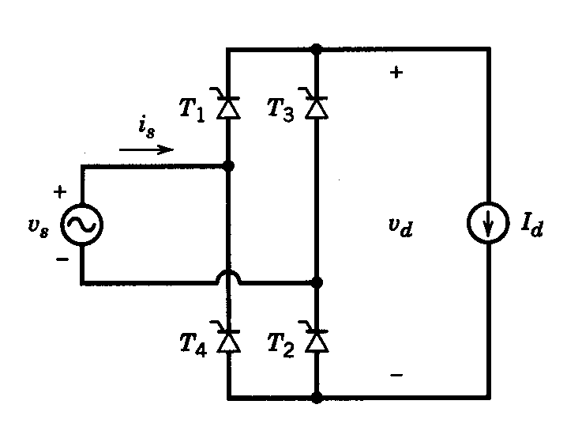
At ∏ + α, T₃ and T₄ are turned on
T₁ and T₂ are line commutated
∏ + α → 2∏ + α
T₃ and T₄ conduct.
V_{d} = - V_{s}
i_{s} = -i_{d}
V_{T1} = v_{s} = V_{T2}

Slide 15
R – L Load, constant load current I_{d}
α →∏ + α
T₁ and T₂ conduct,
T₃ and T₄ are line commutated
V_{d} = V_{s}
i_{s} = I_{d}
V_{T3} = - v_{s} = V_{T4}
∏ + α →2∏ + α
T₃ and T₄ conduct,
T₁ and T₂ are line commutated
V_{d} =- V_{s}
i_{s} = -I_{d}
V_{T1} = v_{s} = V_{T2}

Slide 16
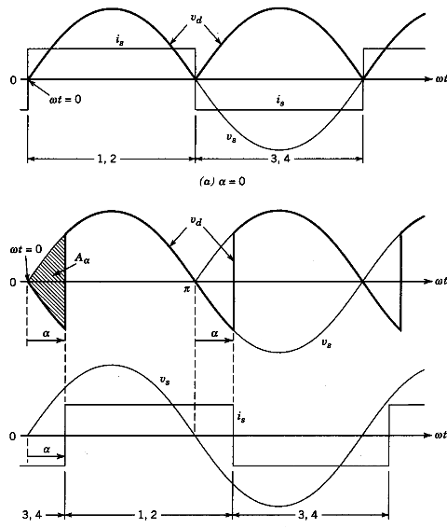

Slide 17
Performance parameters
DC Side
Average load voltage
V_{dRMS}
Average Power through the converter =
P=V_{davg} I_{d} = 0.9V_{s}I_{d}cosα
Ripple frequency = twice the line frequency
Voltage Ripple Factor K_{v} =

Slide 19
RMS value of i_{s1} I_{s1} =
RMS value of n^{th} harmonic i_{sn} I_{sn} =
n = 3, 5, 7,……
RMS value of total source current i_{s}
I_{s} = I_{d}

Slide 20
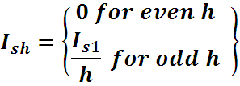
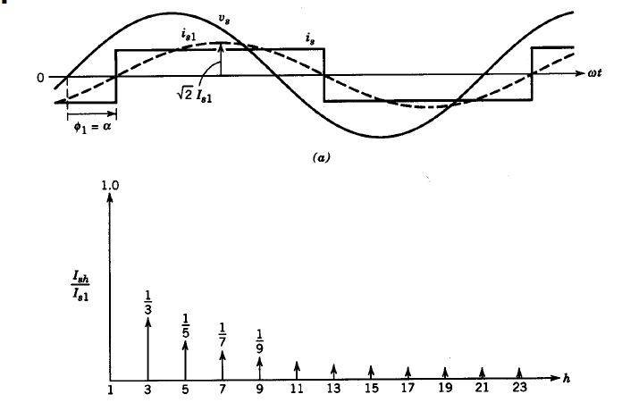
Harmonic spectrum

Slide 21
Total harmonic distortion THD =
%
Displacement factor
DF = cos(-α) = cos α
Ac side Power factor =

Slide 22
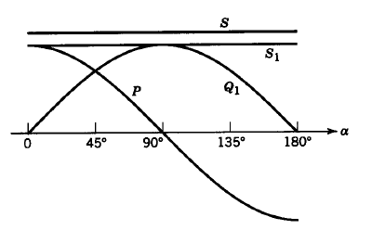

Power at the source side
Total apparent Power S = V_{s}I_{s}
Active Power P
Fundamental frequency current results in fundamental reactive volt amperes
Q₁ = V_{s} I_{s1}sinφ₁ ₌ V_{s} I_{s1}sinα
Fundamental frequency apparent power
S₁= V_{s} I_{s1}

Slide 23
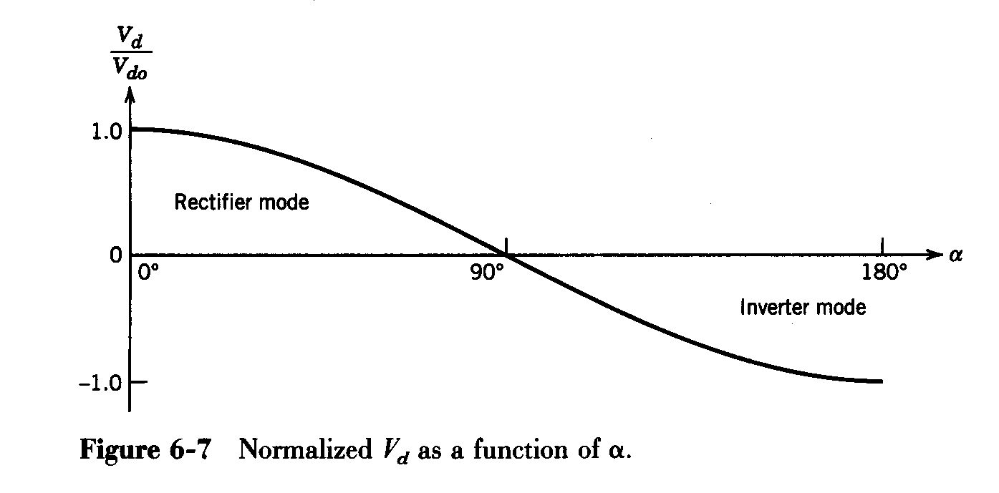
V_{davgα}/ V_{davg0}

Slide 24
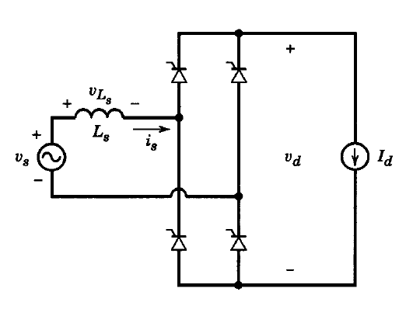
Effect of source inductance
The current commutation takes a finite time called µ or commutation interval
constant load current I_{d}
0 → α
T₃ and T₄ are on
T₁ and T₂ are off
v_{d} = -v_{s}
i_{d} = I_{d}
i_{s} =- I_{d}
V_{T3} = 0 = V_{T4}
V_{T1} = v_{s} = V_{T2}
At α , T₁ and T₂ are turned on

Slide 25
α → α + μ
i_{T3} and i_{T4} decrease from I_{d} → 0
i_{T1} and i_{T2} rise from 0 → I_{d}
T_{1 ,} T_{2,} T_{3,} T₄ are on
V_{d} = 0, i_{d} = I_{d}
i_{s} varies from –I_{d} to → I_{d}.
v_{Ls} = v_{s}
At (α + μ), i_{T3} = 0 = i_{T4} T₃ and T₄ are turned off naturally

Slide 26
α + μ → ∏ + α
T₁ and T₂ are on
T₃ and T₄ are off
v_{d} = v_{s}
i_{d} = I_{d}
i_{s} = I_{d}
V_{T1} = 0 = V_{T2}
V_{T3} =- v_{s} = V_{T4}
At ∏ + α , T₃ and T₄ are turned on

Slide 27
∏ + α → ∏+ α + μ
i_{T1}, i_{T2} decreases from I_{d} → 0
i_{T3}, i_{T4} rises from 0 → I_{d}
T_{1 ,} T_{2,} T_{3,} T₄ conduct
V_{d} = 0, i_{d} = I_{d}
i_{s} varies from +I_{d} to → - I_{d}.
v_{Ls} = v_{s}
At (∏ +α + μ), i_{T1} = 0 = i_{T2} T₁ and T₂ are turned off

Slide 28
∏ +α + μ → 2∏ + α
T₃ and T₄ are on
T₁ and T₂ are off
v_{d} = - v_{s}
i_{d} = I_{d}
i_{s} =- I_{d}
V_{T1} = v_{s} = V_{T2}
V_{T3} = 0 = V_{T4}
v_{Ls} = 0

Slide 29

During the commutation period µ, T₁, T₂, T₃ and T₄ are on

Slide 30
Average o/p voltage =

Slide 31



Practical thyristor converters
Shape of the load current depends on
load parameters and firing angle.
Discontinuous Load Current Mode
i_{d}(ωt) =
$=\frac{\sqrt{2}V_{s}}{Z}sin\left(ωt−∅\right)−\frac{E_{d}}{R}+Ke^{−\frac{R}{L}t}$
K =
$\left[\frac{E_{d}}{R}−\frac{\sqrt{2}V_{s}}{Z}sin(α−φ)\right]e^{\frac{Rα}{ωL}}$
$m=\frac{E_{d}}{\sqrt{2}V_{s}}$
i_{d}(ωt) =
When T₁ and T₂ are conducting,
Z=$\sqrt{R^{2}+ω^{2}L2}$.
𝛟=tan⁻¹$\frac{ωL}{R}$
At ωt = α, i_{d}(ωt) = 0

Slide 32

i_{d}(ωt) =
$=\frac{\sqrt{2}V_{s}}{Z}sin\left(ωt−∅\right)−\frac{E_{d}}{R}+$
$\left[\frac{E_{d}}{R}−\frac{\sqrt{2}V_{s}}{Z}sin(α−φ)\right]e^{\frac{Rα}{ωL}} e^{−\frac{R}{L}t}$

Slide 33
Continuous current mode
Average value of V_{d} is approximately
I_{dmin} is the minimum value of i_{d} that
occurs at ωt=α
Instantaneous value of load voltage
In steady state, i_{d}(0) = i_{d}(T)
In terms of average values,
V_{davg} = r_{d}I_{d} + E_{d}
By controlling α, I_{d} and hence power delivered to the load can be controlled.

Slide 34
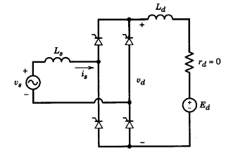
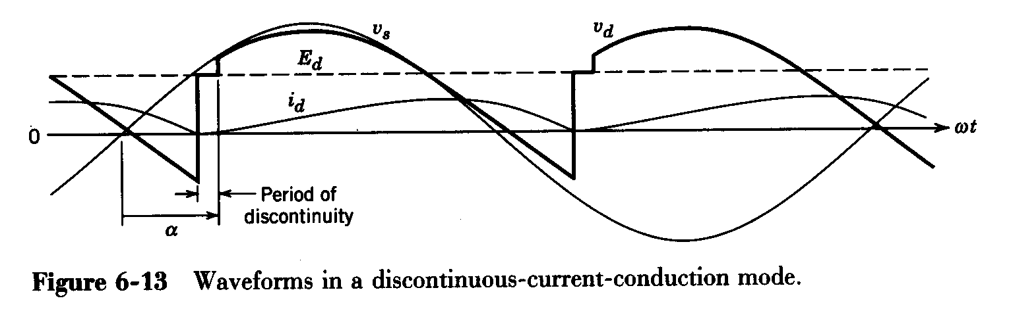
…

Slide 35
Inverter mode of RectifierBridge

Slide 36


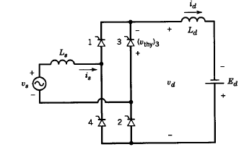
Inverter mode of operation
Average value of V_{d} is negative for
Power flows from dc load to ac source side
P_{dc} =V_{davg} I_{davg} is negative
P_{ac} =V_{s} I_{s1} cosФ₁ is negative as
The voltage source on dc side can be
battery / photovoltaic source /
wind-electric generating system

Slide 37
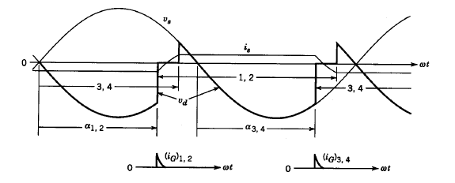

Slide 38



Assuming constant I_{d}, and as drop across L_{d} is zero
E_{d} = V_{d} =
The extinction angle γ of thyristor is =
Extinction time interval should be greater than thyristor turn off time t_{q}

